Slide 1




Noida Institute of Engineering and Technology, Greater Noida
WEB DEVELOPMENT USING MEAN STACK
Unit: IV
Building Single Page App with Angular js
Manisha Pundir Sajwan
(Asst. Professor)
CSE DS Department
Course Details (B. Tech. 6th Sem)

Slide 2
Faculty Introduction
Name | Manisha Pundir Sajwan
Qualification | Ph.D. Pursuing, M. Tech. (Computer Engineering)
Designation | Assistant Professor
Department | Computer Science & Engineering(DS)
Total Experience | 8 years
NIET Experience | 6months
Subject Taught | Data Structures, C Programming, Web Technology, Computer Graphics.

Slide 3
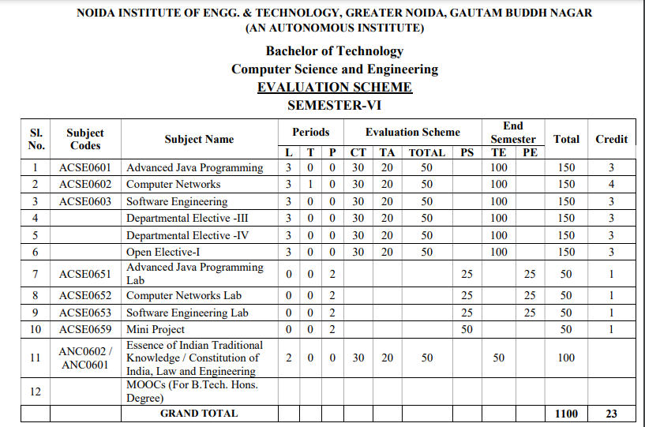
Evaluation Scheme

Slide 4
Syllabus
UNIT-I: Introduction to Nodejs
Installing Nodejs, Node in-built packages (buffer, fs, http, os, path, util, url)Node.js modules, File System Module, Json data, Http Server and Client, Error handling with appropriate HTTP, Callback function, asynchronous programing REST API’s(GET, POST PUT, DELETE UPDATE), Graph, Promises, Promise Chaining, Introduction to template engine (EJS).

Slide 5
Syllabus
UNIT-II: Express Framework
Configuring Express, Postman configuration, Environment Variables, Routing, Defining pug templates, HTTP method of Express, URL binding, middleware function, Serving static files, Express sessions, REST full API’s, FORM data in Express, document modeling with Mongoose.

Slide 6
Syllabus
UNIT-III: Basics of Angular js
Typescript, Setup and installation, Power of Types , Functions Function as types Optional and default parameters, Arrow functions, Function overloading, Access modifiers, Getters and setters, Read-only & static, Abstract classes, Interfaces, Extending and Implementing Interface, Import and Export modules.

Slide 7
Syllabus
UNIT-IV: Building Single Page App with Angular js
MVC Architecture, One-way and Two-way data binding, AngularJS Expressions, AngularJS Controllers, AngularJS Modules, adding controller to a module, Component, Dependency Injection, Filters, Tables, AngularJS Forms and Forms validation, Select using ng-option, AngularJS AJAX.

Slide 8
Syllabus
UNIT-V: Connecting Angular js with MongoDB
Environment Setup of Mongo dB , data modeling ,The current SQL/NoSQL landscape, Create collection in Mongo dB, CRUD Operations in MongoDB. Mongo's feature set, Introduction to Mongoose, understanding mongoose schemas and datatypes, Connecting Angular with mongo dB using API.

Slide 9
Branch Wise Application
1. Real time web analytics
2. Digital Advertising
3. E-Commerce
4. Publishing
5. Massively Multiplayer Online Games
6. Backend Services and Messaging
7. Project Management & Collaboration
8. Real time Monitoring Services
9.Live Charting and Graphing
10. Group and Private Chat

Slide 10
Course Objective
In this semester, the students will
Study how to design and build static as well as dynamic webpages and interactive web applications
Students examine advanced topics like Angular, nodejs, Mongodb for web applications.
Also examine Express framework for interactive web applications that use rich user interfaces .

Slide 11
Course Outcomes (COs)
At the end of course, the student will be able to:
CO1 : Explain, analyze and apply the role of server-side scripting language like Nodejs .
CO2 : Demonstrate Express framework to design and implement dynamic web pages.
CO3 : Apply the knowledge of Typescript that are vital in understanding angular js.
CO4 : Analyze build and develop single page application using client-side programming.
CO5 : Understand the impact of web designing by database connectivity with Mongodb

Slide 12
Program Outcomes (POs)
Engineering Graduates will be able to:
PO1 : Engineering Knowledge
PO2 : Problem Analysis
PO3 : Design/Development of solutions
PO4 : Conduct Investigations of complex problems
PO5 : Modern tool usage
PO6 : The engineer and society

Slide 13
Program Outcomes (POs)
Engineering Graduates will be able to:
PO7 : Environment and sustainability
PO8 : Ethics
PO9 : Individual and teamwork
PO10 : Communication
PO11 : Project management and finance
PO12 : Life-long learning

Slide 14

COs - POs Mapping
CO.K | PO1 | PO2 | PO3 | PO4 | PO5 | PO6 | PO7 | PO8 | PO9 | PO10 | PO11 | PO12
CO1 | 2 | 2 | 2 | 3 | 3 | - | - | - | - | - | - | -
CO2 | 3 | 2 | 3 | 2 | 3 | - | - | - | - | - | - | -
CO3 | 3 | 2 | 3 | 2 | 3 | - | - | - | - | - | - | -
CO4 | 3 | 2 | 3 | 2 | 3 | - | - | - | - | - | - | -
CO5 | 3 | 2 | 3 | 3 | 3 | - | - | - | - | - | - | -
AVG | 2.8 | 2.0 | 2.8 | 2.4 | 3.0 | - | - | - | - | - | - | -

Slide 15
Program Specific Outcomes(PSOs)
S. No. | Program Specific Outcomes (PSO) | PSO Description
1 | PSO1 | Understand to shows relationships and interactions between classes or objects of a pattern.
2 | PSO2 | Study to speed up the development process by providing well-tested, proven development
3 | PSO3 | Select a specific design pattern for the solution of a given design problem
4 | PSO4 | Create a catalogue entry for a simple design pattern whose purpose and application is understood.

Slide 16
COs - PSOs Mapping
CO.K | PSO1 | PSO2 | PSO3 | PSO4
CO1 | 3 | - | - | -
CO2 | 3 | 3 | - | -
CO3 | 3 | 3 | - | -
CO4 | 3 | 3 | - | -
CO5 | 3 | 3 | - | -

Slide 17
Program Educational Objectives (PEOs)
Program Educational Objectives (PEOs) | PEOs Description
PEOs | To have an excellent scientific and engineering breadth so as to comprehend, analyze, design and provide sustainable solutions for real-life problems using state-of-the-art technologies.
PEOs | To have a successful career in industries, to pursue higher studies or to support entrepreneurial endeavors and to face the global challenges.
PEOs | To have an effective communication skills, professional attitude, ethical values and a desire to learn specific knowledge in emerging trends, technologies for research, innovation and product development and contribution to society.
PEOs | To have life-long learning for up-skilling and re-skilling for successful professional career as engineer, scientist, entrepreneur and bureaucrat for betterment of society.

Slide 18
Result Analysis(Department Result & Subject Result & Individual result
Name of the faculty | Subject code | Result % of clear passed
Mr. Rahul Kumar | ACSE0614

Slide 19
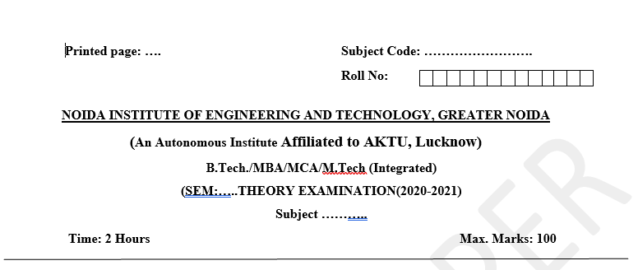
Pattern of Online External Exam Question Paper (100 marks)

Slide 20
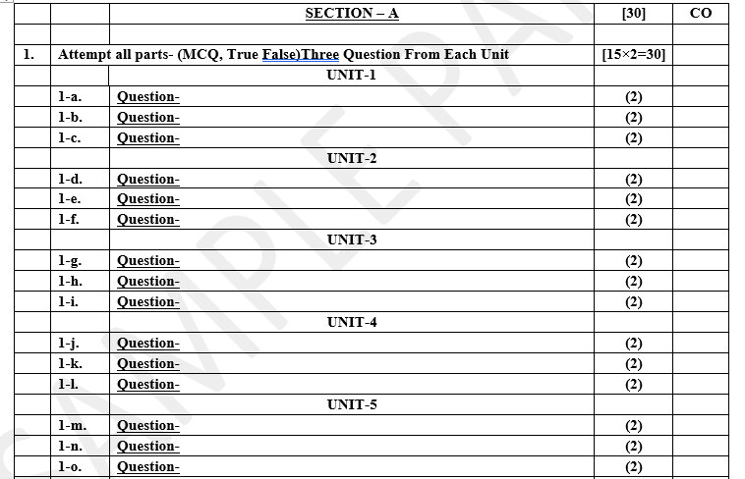
Pattern of Online External Exam Question Paper (100 marks)

Slide 21
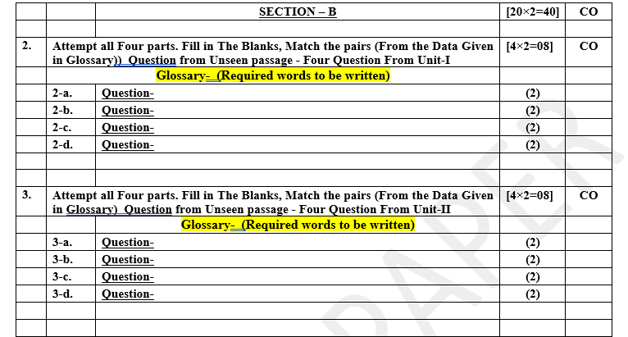
Pattern of Online External Exam Question Paper (100 marks)

Slide 22
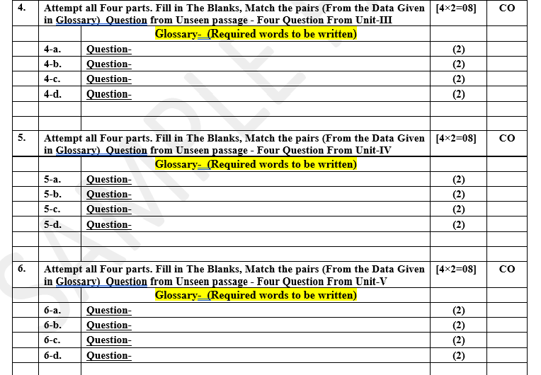
Pattern of Online External Exam Question Paper (100 marks)

Slide 23
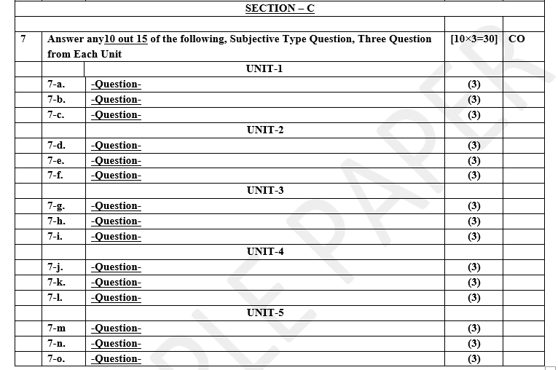
Pattern of Online External Exam Question Paper (100 marks)

Slide 24
Prerequisite / Recap
Student should have knowledge of Web technology and terminology.
Knowledge of HTML ,CSS and Java Script required .
knowledge of Programing language such as C/C++/Python etc.
Good problem solving Skill .

Slide 25
Brief Introduction about the Subject with videos
YouTube /Other Video Links
https://youtu.be/BLl32FvcdVM
https://youtu.be/v9ejT8FO-7I?list=PLrhzvIcii6GNjpARdnO4ueTUAVR9eMBpc
https://youtu.be/VGLjQuEQgkI?list=PLt4nG7RVVk1h9lxOYSOGI9pcP3I5oblbx

Slide 26
Unit IV Content
MVC Architecture ,One-way and Two-way data binding.
AngularJS Expressions, AngularJS Controllers, AngularJS Modules, adding controller to a module,
Component, Dependency Injection, Filters, Tables
AngularJS Forms and Forms validation, Select using ng-option, AngularJS AJAX.

Slide 27
Unit IV Objective
In Unit IV, the students will be able to Understand
Definitions of MVC and concepts of MVC.
How one way and two way data binding is done.
Angular JS Introduction ,
Angular JS Expressions ,Controllers,Modules.
How we can add Controller to Model.
Depending Injuctions is done.
Angular JS forms validations
Using AJAX calls

Slide 28
Topic Objective
Topic : MVC Architecture
In this topic, the students will gain , what is MVC and its Architecture.
How we can use MCV in AngularJS.

Slide 29
MVC Architecture
MVC: Model View Controller.
In the MEAN stack (MongoDB, Express.js, Angular, Node.js), the MVC (Model-View-Controller) architecture can be implemented to organize the application code into three separate concerns:
Model: Handles the data logic, typically interacting with the MongoDB database.
View: Manages the user interface and presentation layer, which is handled by Angular.
Controller: Processes user requests, manipulates data using models, and returns responses.

Slide 30
MVC Architecture
How MVC Fits in the MEAN Stack:
1. Model (M) – MongoDB + Mongoose (Backend)
The model represents the data layer and is responsible for interacting with the database.
In the MEAN stack, MongoDB stores data in a NoSQL format (JSON-like documents).
Mongoose, an ODM (Object Data Modeling) library, is often used to define schemas and interact with the database.

Slide 31
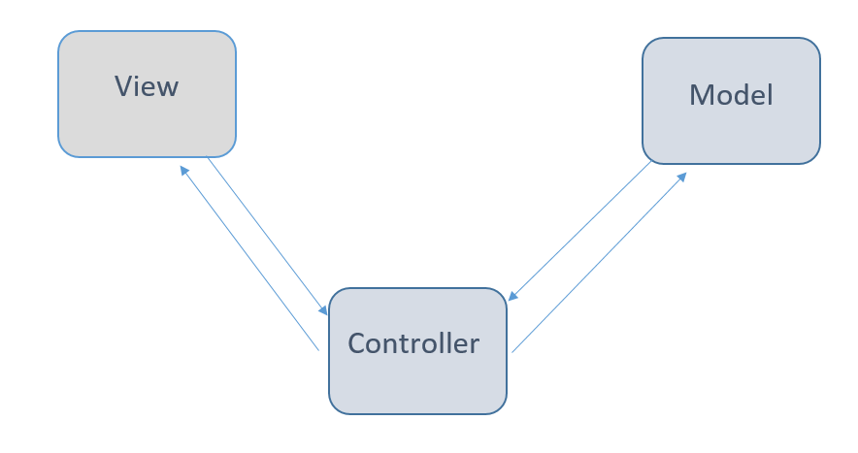
MVC Architecture Cont………
The MVC framework includes the following 3 components:
Controller
Model
View

Slide 32
MVC Architecture Cont………
Controller:
The controller is the component that enables the interconnection between the views and the model so it acts as an intermediary.
The controller doesn’t have to worry about handling data logic, it just tells the model what to do.
It process all the business logic and incoming requests, manipulate data using the Model component and interact with the View to render the final output.

Slide 33
MVC Architecture Cont………
View:
The View component is used for all the UI logic of the application.
It generates a user interface for the user.
Views are created by the data which is collected by the model component but these data aren’t taken directly but through the controller.
It only interacts with the controller.

Slide 34
MVC Architecture Cont………
Model:
The Model component corresponds to all the data-related logic that the user works with.
This can represent either the data that is being transferred between the View and Controller components or any other business logic-related data.
It can add or retrieve data from the database.
It responds to the controller’s request because the controller can’t interact with the database by itself.
The model interacts with the database and gives the required data back to the controller.

Slide 35
MVC Architecture Cont………
Advantages of MVC:
Codes are easy to maintain and they can be extended easily.
The MVC model component can be tested separately.
The components of MVC can be developed simultaneously.
It reduces complexity by dividing an application into three units. Model, view, and controller.
It supports Test Driven Development (TDD).
This architecture helps to test components independently as all classes and objects are independent of each other
Search Engine Optimization (SEO) Friendly.

Slide 36
MVC Architecture Cont………
Disadvantages of MVC:
It is difficult to read, change, test, and reuse this model
It is not suitable for building small applications.
The inefficiency of data access in view.
Increased complexity and Inefficiency of data

Slide 37
AngularJS Data Binding
The data binding is the data synchronization processes that work between the model and view components. In Angular, model treat as source of application and view is the projection of angular model.
In angularjs when model data got changed that time the view data will change automatically and vice versa.
Data binding is a mechanism that connects the user interface (UI) with the application's data logic. In frontend frameworks like Angular, data binding is used to synchronize the data between the component (TypeScript) and the view (HTML).
We have two types of data bindings available in angularjs those are
1. One-Way data binding
2. Two-Way data binding

Slide 38
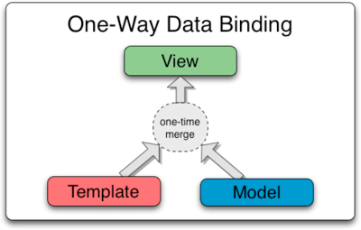
AngularJS Data Binding continue………
AngularJS One-Way Data Binding
In One-Way data binding, view (UI part) not updates automatically when data model changed and we need to write custom code to make it updated every time. Its not a synchronization processes and it will process data in one way

Slide 39
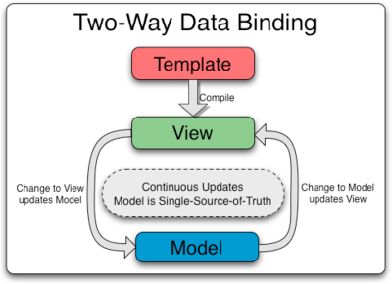
AngularJS Data Binding Cont………
AngularJS Two-way Data Binding
In Two-way data binding, view (UI part) updates automatically when data model changed. Its synchronization processes and two way data binding.
Two-way data binding is achieved by using the ng-model directive

Slide 40
AngularJS Data Binding Cont………
The ng-model directive transfers data from the view to the model and from the model to the view.
How to create two way data binding
Create a module
var app=angular.module('myApp',[])
Add a controller to the module. Here you can write the logic for updating the model as the view changes.
app.controller('myCtrl',function($scope){})
Specify the ng-model directive in the element
<input ng-model="name"/>

Slide 41
AngularJS Expressions
AngularJS expressions can be written inside double braces: {{ expression }}.
AngularJS expressions can also be written inside a directive: ng-bind="expression".
AngularJS will resolve the expression, and return the result exactly where the expression is written.
AngularJS expressions are much like JavaScript expressions: They can contain literals, operators, and variables.
Example {{ 5 + 5 }} or {{ firstName + " " + lastName }}

Slide 42
AngularJS Controllers
AngularJS controllers control the data of AngularJS applications.
AngularJS controllers are regular JavaScript Objects.
AngularJS applications are controlled by controllers.
The ng-controller directive defines the application controller.
A controller is a JavaScript Object, created by a standard JavaScript object constructor.

Slide 43
AngularJS Controllers Cont………
<script>
var app = angular.module('myApp', []);
app.controller('myCtrl', function($scope) {
$scope.firstName = "John";
$scope.lastName = "Doe";
});
</script>
The ng-controller="myCtrl" attribute is an AngularJS directive. It defines a controller.

Slide 44
AngularJS Controllers Cont………
Controllers In External Files
In larger applications, it is common to store controllers in external files.
Just copy the code between the <script> tags into an external file named personController.js:
<script src="personController.js"></script>
<div ng-app="myApp" ng-controller="namesCtrl">
Using controller into our div tag
Priya WEB DEVELOPMENT USING MEAN STACK Unit IV

Slide 45
AngularJS Modules
An AngularJS module defines an application.
The module is a container for the different parts of an application.
The module is a container for the application controllers.
Controllers always belong to a module.
Modules are used to separate logic such as services, controllers, application etc

Slide 46
AngularJS Modules Cont………
Creating a Module
A module is created by using the AngularJS function angular.module
Application Module − used to initialize an application with controller(s).
<div ng-app="myApp">...</div>
<script>
var app = angular.module("myApp", []);
</script>
The "myApp" parameter refers to an HTML element in which the application will run.
Priya WEB DEVELOPMENT USING MEAN STACK Unit IV

Slide 47
AngularJS Modules Cont………
Adding controller to a module
Add a controller to your application using ng-controller directive <div ng-app="myApp" ng-controller="myCtrl">
{{ firstName + " " + lastName }}
</div>
<script>
var app = angular.module("myApp", []);
app.controller("myCtrl", function($scope) {
$scope.firstName = "John";
$scope.lastName = "Doe";
});
</script>

Slide 48
Component
A component in Angular is an isolated entity that enables reuse and maintainability of the code.
In simple terms, a component can be considered as a method/function that not only contains the controller logic required for a UI element to function but also the corresponding HTML tags to generate the element.
A component is basically a directive that uses a simpler configuration and that is suitable for a component-based architecture

Slide 49
Component Cont.....
The syntax to create a component is fairly easy. All you have to do is declare its name and pass a config object that specifies what your component should do. In our case, it will render some basic HTML:
angular.module("myApp", [])
.component("helloWorld",{
template: 'Hello World!'
});
In order to then use that component in our code, all we need is this:
<div ng-app="myApp">
<hello-world> </hello-world>
</div>

Slide 50
Dependency Injection
Dependency Injection is a software design in which components are given their dependencies instead of hard coding them within the component.
It relieves a component from locating the dependency and makes dependencies configurable.
It also helps in making components reusable, maintainable and testable.
AngularJS provides a supreme Dependency Injection mechanism.
It provides following core components which can be injected into each other as dependencies.

Slide 51
Dependency Injection Cont....
Value
Factory
Service etc
Value
Value is a simple JavaScript object, which is required to pass values to the controller during config phase
var mainApp = angular.module("mainApp", []);//define a module
//create a value object as "defaultInput" and pass it a data.
mainApp.value("defaultInput", 5);
//inject the value in the controller using its name "defaultInput"
mainApp.controller('CalcController', function($scope, CalcService, defaultInput)

Slide 52
Dependency Injection Cont....
Factory
Factory is a function which is used to return value. It creates a value on demand whenever a service or a controller requires it. It generally uses a factory function to calculate and return the value.
var mainApp = angular.module("mainApp", []);//define a module
//create a factory "MathService" which provides a method multiply to return multiplication of two numbers
mainApp.factory('MathService', function() {-----}
/inject the factory "MathService" in a service to utilize the multiply method of factory.
mainApp.service('CalcService', function(MathService) {---}

Slide 53
Dependency Injection Cont....
Service
Service is a singleton JavaScript object containing a set of functions to perform certain tasks. Service is defined using service() function and it is then injected into the controllers.
var mainApp = angular.module("mainApp", []);//define a module
//create a service which defines a method square to return square of a number.
mainApp.service('CalcService', function(MathService) {---}
//inject the service "CalcService" into the controller
mainApp.controller('CalcController', function($scope, CalcService, defaultInput) {--}

Slide 54
Filters
AngularJS provides filters to transform data:
currency Format a number to a currency format.
date Format a date to a specified format.
filter Select a subset of items from an array.
json Format an object to a JSON string
limitTo Limits an array/string, into a specified number of elements/characters.
lowercase Format a string to lower case.
number Format a number to a string.
orderBy Orders an array by an expression.
uppercase Format a string to upper case.

Slide 55
Filters Cont......
Filters can be added to expressions by using the pipe character |, followed by a filter.
The uppercase filter format strings to upper case:
<div ng-app="myApp" ng-controller="personCtrl">
<p>The name is {{ lastName | uppercase }}</p>
</div>
The lowercase filter format strings to lower case:
<div ng-app="myApp" ng-controller="personCtrl">
<p>The name is {{ lastName | lowercase }}</p>
</div>
Filters are added to directives, like ng-repeat, by using the pipe character |, followed by a filter.

Slide 56
Tables
The ng-repeat directive is perfect for displaying tables.
Displaying Data in a Table
<div ng-app="myApp" ng-controller="customersCtrl">
<table>
<tr ng-repeat="x in names">
<td>{{ x.Name }}</td>
<td>{{ x.Country }}</td></tr></table></div><script>
var app = angular.module('myApp', []);
app.controller('customersCtrl', function($scope, $http) {
$http.get("customers.php")
.then(function (response) {$scope.names = response.data.records;});});</script>

Slide 57
Tables Cont....
To sort the table, add an orderBy filter.
<table>
<tr ng-repeat="x in names | orderBy : 'Country'">
<td>{{ x.Name }}</td>
<td>{{ x.Country }}</td></tr></table>
To display uppercase, add an uppercase filter:
<td>{{ x.Country | uppercase }}</td>
To display the table index, add a <td> with $index:
<td>{{ $index + 1 }}</td>
Using $even and $odd
<td ng-if="$even">{{ x.Name }}</td>

Slide 58
AngularJS Forms
Forms in AngularJS provides data-binding and validation of input controls.
Input controls are the HTML input elements:
input elements,select elements
button elements,textarea elements
Input controls provides data-binding by using the ng-model directive.
<input type="text" ng-model="firstname">
<script>
var app = angular.module('myApp', []);
app.controller('formCtrl', function($scope) {
$scope.firstname = "John";});</script>

Slide 59
AngularJS Forms Cont....
A checkbox has the value true or false. Apply the ng-model directive to a checkbox, and use its value in your application.
<form>
<input type="checkbox" ng-model="myVar">
</form>
<h1 ng-show="myVar">My Header</h1>
Bind radio buttons to your application with the ng-model directive.
Radio buttons with the same ng-model can have different values.
<form>
<input type="radio" ng-model="myVar" value="dogs">Dogs
<input type="radio" ng-model="myVar" value="tuts">Tutorials
</form>

Slide 60
AngularJS Forms Cont....
Bind select boxes to your application with the ng-model directive.
The property defined in the ng-model attribute will have the value of the selected option in the selectbox.
<form>
Select a topic:
<select ng-model="myVar">
<option value="select any one" selected>
<option value="dogs">Dogs
<option value="tuts">Tutorials
<option value="cars">Cars
</select>
</form>

Slide 61
AngularJS Forms Cont....
Bind select boxes to your application with the ng-model directive.
The property defined in the ng-model attribute will have the value of the selected option in the selectbox.
<form>
Select a topic:
<select ng-model="myVar">
<option value="select any one" selected>
<option value="dogs">Dogs
<option value="tuts">Tutorials
<option value="cars">Cars
</select>
</form>

Slide 62
Forms validation
AngularJS can validate input data.
AngularJS offers client-side form validation.
AngularJS monitors the state of the form and input fields (input, textarea, select), and lets you notify the user about the current state.
AngularJS also holds information about whether they have been touched, or modified, or not.
You can use standard HTML5 attributes to validate input, or you can make your own validation functions.

Slide 63
Forms validation Cont...
Required
Use the HTML5 attribute required to specify that the input field must be filled out.
The input field is required:
<form name="myForm">
<input name="myInput" ng-model="myInput" required>
</form>
<p>The input's valid state is:</p>
<h1>{{myForm.myInput.$valid}}</h1>

Slide 64
Forms validation Cont...
E-mail
Use the HTML5 type email to specify that the value must be an e-mail.
The input field has to be an e-mail.
<form name="myForm">
<input name="myInput" ng-model="myInput" type="email" placeholder=”Enter your Email”>
</form>
<p>The input's valid state is:</p>
<h1>{{myForm.myInput.$valid}}</h1>

Slide 65
Forms validation Cont...
AngularJS is constantly updating the state of both the form and the input fields.
Input fields have the following states:
$untouched The field has not been touched yet
$touched The field has been touched
$pristine The field has not been modified yet
$dirty The field has been modified
$invalid The field content is not valid
$valid The field content is valid

Slide 66
Forms validation Cont...
They are all properties of the input field, and are either true or false.
Forms have the following states:
$pristine No fields have been modified yet
$dirty One or more have been modified
$invalid The form content is not valid
$valid The form content is valid
$submitted The form is submitted
They are all properties of the form, and are either true or false.

Slide 67
using ng-option
The ng-options Directive in AngularJS is used to build and bind HTML elements with options to a model property.
It is used to specify <options> in a <select> list.
It is designed specifically to populate the items on a dropdown list.
This directive implements an array, in order to fill the dropdown list. It is supported by the <select> element.
<element ng-options="expression">
Content ...
</element>

Slide 68
AngularJS AJAX
$http is an AngularJS service for reading data from remote servers.
The AngularJS $http service makes a request to the server, and returns a response.
<div ng-app="myApp" ng-controller="myCtrl">
<h1>{{myWelcome}}</h1></div>
<script>
var app = angular.module('myApp', []);
app.controller('myCtrl', function($scope, $http) {
$http.get("https://MeanNietCse.com")
.then(function(response) {
$scope.myWelcome = response.data; });});</script>

Slide 69
AngularJS AJAX Cont...
Methods
The example above uses the .get method of the $http service.
The .get method is a shortcut method of the $http service. There are several shortcut methods:
.delete()
.get()
.head()
.jsonp()
.patch()
.post()
.put()
The methods above are all shortcuts of calling the $http service.

Slide 70
AngularJS AJAX Cont...
Properties
The response from the server is an object with these properties:
.config the object used to generate the request.
.data a string, or an object, carrying the response from the server.
.headers a function to use to get header information.
.status a number defining the HTTP status.
.statusText a string defining the HTTP status.
then(()=>{$scope.content = response.data;
$scope.statuscode = response.status;
$scope.statustext = response.statusText;});

Slide 71
Daily Quiz
Q 1 - Which of the following is true about AngularJS expressions?
A - Expressions are used to bind application data to html.
B - Expressions are written inside double braces like {{ expression}}.
C - Expressions behave in same way as ng-bind directives.
D - All of the above.
Q 2 - AngularJS application expressions are pure JavaScript expressions.
A - false
B – true
Q 3 - Which of the following is true about currency filter?
A - Currency filter formats text in a currency format.
B - Currency filter is a function which takes text as input.
C - Both of the above.
D - None of the above.

Slide 72
Daily Quiz
Q 4 -$rootScope is the parent of all of the scope variables?
A - true
B - false
Q 5 - Custom directives are defined using "directive" function?
A - true
B - false

Slide 73
Weekly Assignment
What is MVC Architecture
For what resion we use two way binding in AngularJS.
Justify AngularJS Expression with example.
Create student registration using Angularjs forms.
Display data on UI using AJAX.

Slide 74
Topic Link ( YouTube & NPTEL Video Links)
YouTube /other Video Links
https://www.youtube.com/watch?v=zKkUN-mJtPQ&list=PL6n9fhu94yhWKHkcL7RJmmXyxkuFB3KSlhttps://youtu.be/v9ejT8FO-7I?list=PLrhzvIcii6GNjpARdnO4ueTUAVR9eMBpc
https://www.youtube.com/watch?v=0LhBvp8qpro

Slide 75
MCQ (End of Unit)
1. Which of the following is an in-built service in angular JS?
$http
$route
$windows
All of the above
2. Which directive display view for various routes?.
ng-view
ng-model
ng-display
None of the above

Slide 76
MCQ (End of Unit)
3. What is the priority level of directives?
Level 1
Level 2
Level 3
Level 4
4. Which service is used to communicate with remote server?
$interval
$http
$animate
$timeout

Slide 77
Glossary Questions
Top 10 design pattern interview questions
What are MVC Architecture?
How to one way and two way data binding works?
Explain AngularJS expression using exmaple.
Explain various Modules in AngularJS .
Differentiate one way and two way data binding?
Create a Model using example?
What are various filters used in angularJS?
Explain Tables using example?
How to implement input field in angularJS forms.
What is AngularJS AJAX?

Slide 78
Expected Questions for University Exam
What are MVC Architecture?
How to one way and two way data binding works?
Explain AngularJS expression using exmaple.
Explain various Modules in AngularJS .
Differentiate one way and two way data binding?
Create a Model using example?
What are various filters used in angularJS?
Explain Tables using example?
How to implement input field in angularJS forms.
What is AngularJS AJAX?

Slide 79
Summary
Till Now we understand, MVC Architecture, How can we implement MVC into our angularJS application,How one way and two way binding works,Implementing AngularJS expression into our application,How can we use Controllers and various Models in AngularJS ,Adding Dependency Injection to application,How can we make table in AngularJS,Using various filters into our application,How to create and validate Forms using AngularJS,Getting Data from remote server using AngularJS AJAX calls.

Slide 80
References
Simon Holmes, Clive Herber, “Getting MEAN with Mongo, Express, Angular, and Node”, 2nd Edition 2016, Addison Wesley Publication.
Dhruti Shah, “Comprehensive guide to learn Node.js”, 1st Edition, 2018 BPB Publications.
Christoffer,Noring,Pablo,Deeleman,“Learning Angular”,3rd Edition,2017 Packt publications. .
Peter Membrey, David Hows, Eelco Plugge, “MongoDB Basics”, 2nd edition, 2018, International Publication.
Christoffer Noring, Pablo Deeleman, “Learning Angular”,3rd Edition,

Slide 81
THANK YOU

